Slide 1
"Brotherhood of the Neighborhoods"
Capstone Project - The Battle of the Neighborhoods
By Konstantin Skrochinsky, Russia

Slide 2
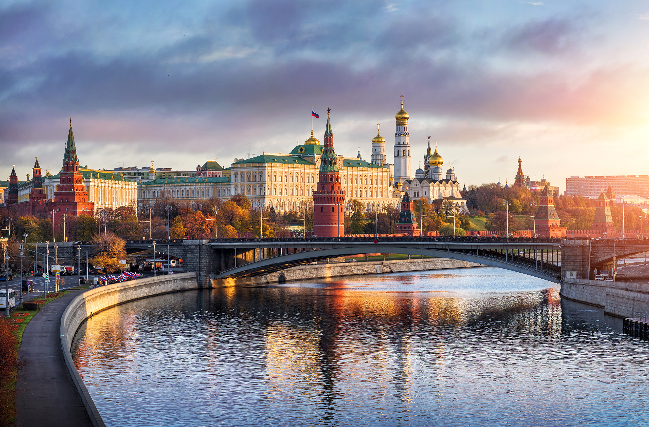
Introduction
The purpose of this project is the districts of Moscow, Russia.
For those who are not familiar with the history of the city, there is a very short excursion: The city was founded in 1147, Yuri Dolgoruky, and has a large number of cultural heritage sites (hereinafter referred to as OKN) on its territory. The whole city is divided into districts, which in turn are divided into districts and settlements (125 districts and 21 settlements).

Slide 3
Analysis Objective
This project will go through several stages of work on the data of the city districts regarding cultural heritage objects ... and not only:
Classification of OKN according to their properties
Classification of city districts according to their cultural heritage objects
Obtaining infrastructure data within walking distance and creating a new classification of districts, taking into account the infrastructure that surrounds the monuments
Engage the Foursquare API and work with it
Let us analyze the ratio of the number of objects of cultural heritage and its relation to the average cost of an apartment
Data visualization on a map of Moscow and just graphics

Slide 4
Preparation and data cleaning
Cleaning main dataset with cultural object from empty fields
Fill field contains information on whether the object belongs to the ensemble
To get data the average cost per square meter of housing in the areas of Moscow by parsing. Fill table new data
To simplify the data model, we will take data on the geolocation of cultural objects only through their center – work with GEOJSON file
In the data table with the districts we add information on the prices of apartments in the same areas
Again we clean the names of the districts, but already in the main data frame, which contains data on the OKN

Slide 5
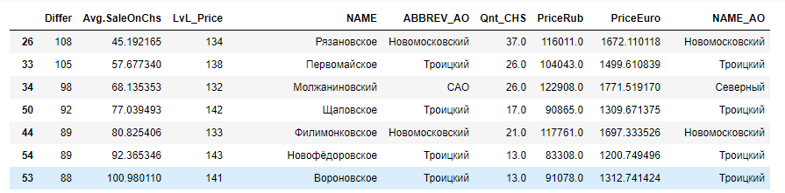
Methodology and Data Analysis. Create DataFrames
Number of districts without OKN: 23
Total districts: 146
District Khamovniki
the most expensive area - 10888 euros per sq.m (Ostozhenka and Prestizhenka streets make their contribution)
the largest number of OKN - 1448 pcs. (one of the oldest districts of Moscow)
Indicator Differ - 0 (zero) the most balanced area for this indicator
The lowest rate Avg.SaleOnChs - only 7.51 euros for one OKN in sq.m (no matter how strange it sounds)

Slide 6
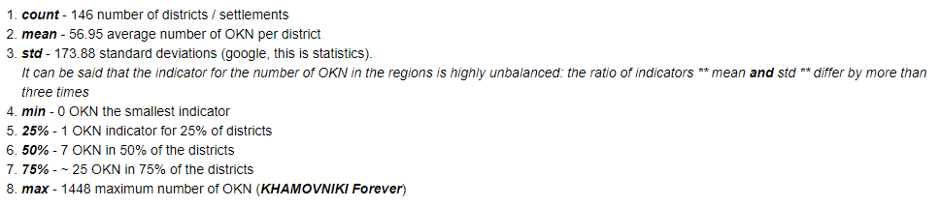
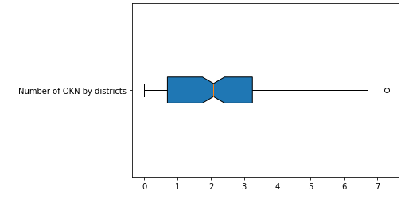
Methodology and Data Analysis. Statistic
The number of cultural heritage sites in each district
Only 13 districts have more than 100 OKN in their territory. Logically, the historical city center has the largest number of objects. And yes, the Khamovniki district with 1,448 objects is allocated against this background among all the districts. And as you can see from the table with housing prices - this is the most expensive area of Moscow. By the way, more than 50% of the OKN in the Khamovniki area is brought by the “Novodevichy Convent Ensemble” and the Novodevichy Cemetery burial site.

Slide 7
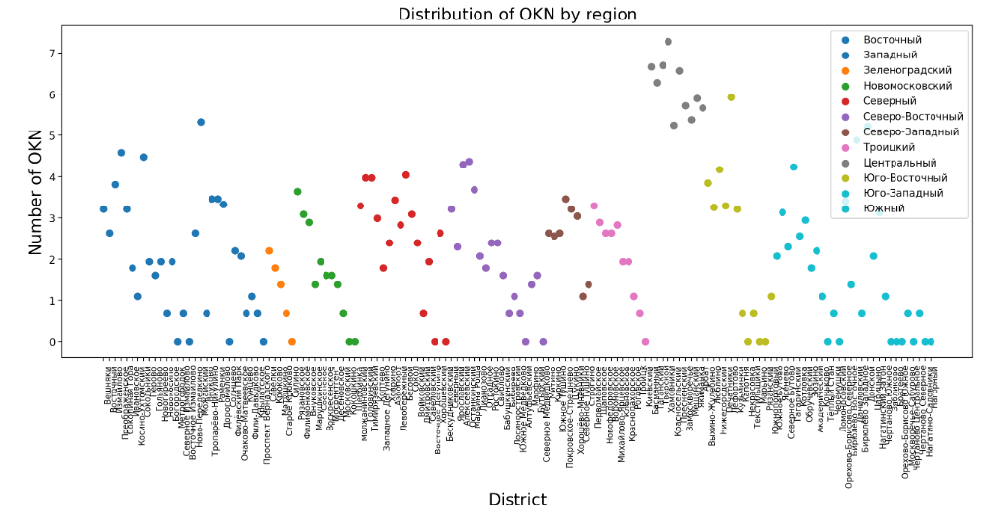
Methodology and Data Analysis. Area and Districts
A bunch of gray dots to the right and up is a galaxy of "elite" districts of the Central District. Four "stars" trying to reach the same heights are the green "star" to the right of the galaxies - "Lefortovo" from the South-East of the okrug, the "Mozhayskaya" star from the West and turquoise "stars" - "Donskaya" and "Danilovskaya" from the Southern District.

Slide 8
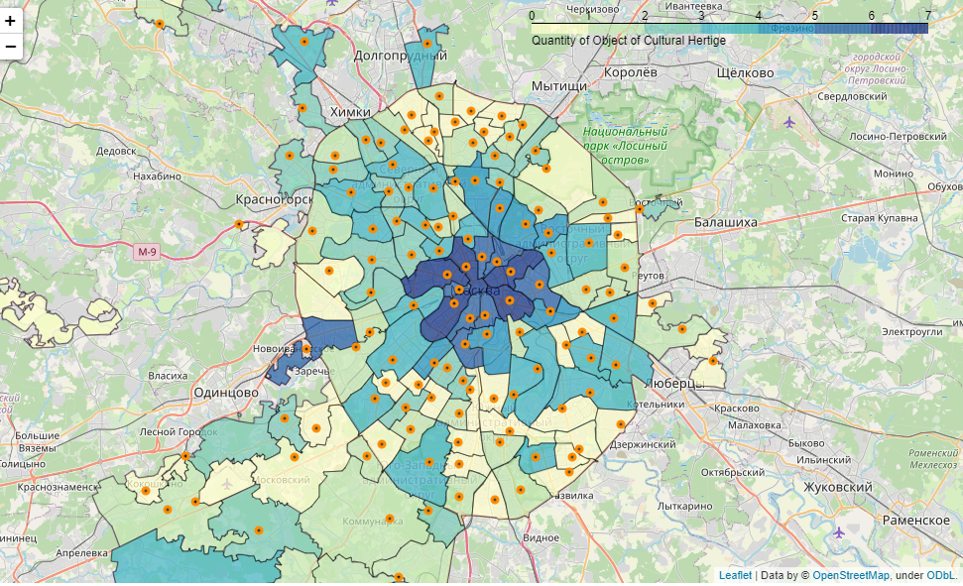
Choropleth of Moscow with a color scheme by the number of monuments in the districts
The superiority of the historical center over other districts is clearly visible. The South-Eastern District holds the second place at the expense of the Lefortovo district - with the date of foundation in 1699, it is rightfully one of the old districts of Moscow and has a decent number of monuments allowing it to compete with the central regions.

Slide 9
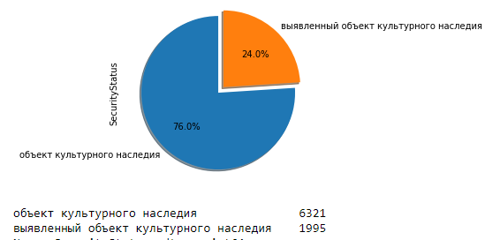
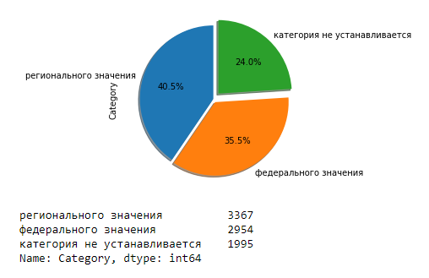
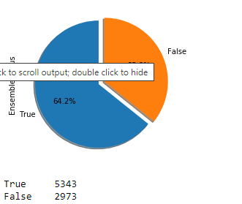
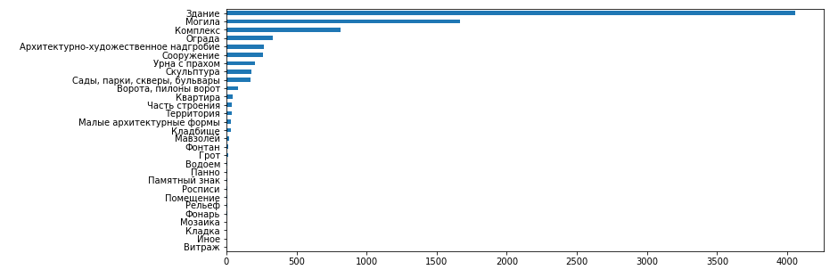
Segmentation of OKN and districts by the k-means method. DataFrame of OKN
SecurityStatus - the status of the object according to its protected level. “Identified object of cultural heritage”(orange) is a relatively new window that will change its status when it is entered into the registry.
Category - the status of the object relative to its value for history (not sure if it was correctly expressed). The highest level is “Federal Significance”(orange), the medium level is “Regional”(blue) and the lowest is “category is not established”(green) in our case.
EnsembleStatus - We have already talked about this indicators, the status of the entry of the object into the ensemble.
ObjectType - it’s quite simple here - it is a classification according to the type of objects.
And note that a huge number of objects are associated with burial: Grave, Tombstone, Urn with ashes, Cemetery, Mausoleum. It is possible that data of this type could be given an additional status that clearly expresses their affiliation. But in this paper we will not do this, we will leave all the additional improvements for the next version.

Slide 10
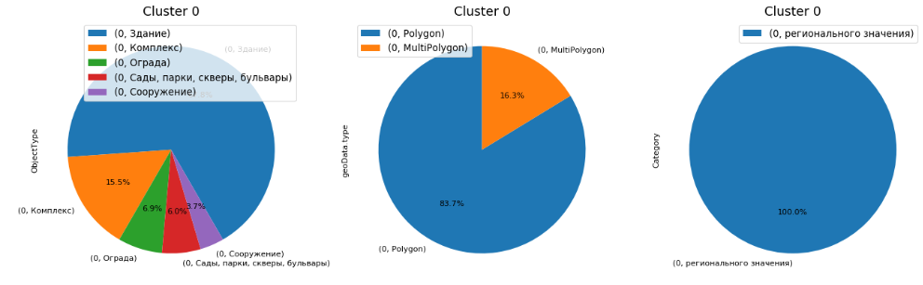
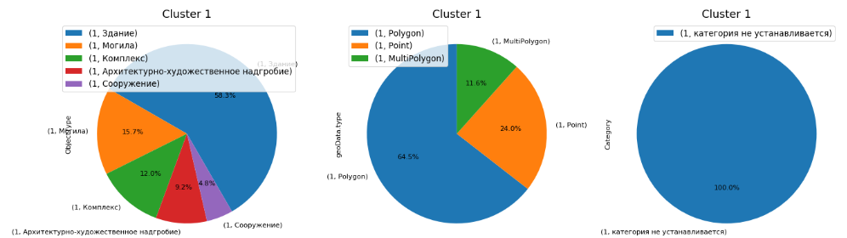
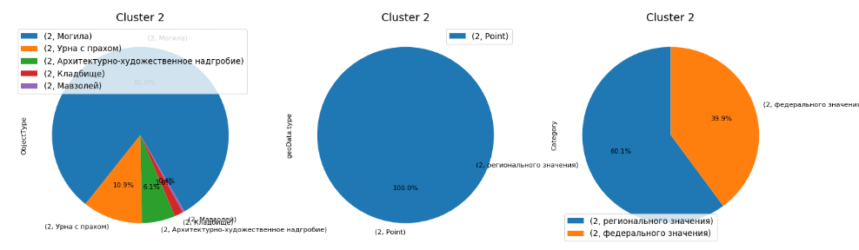
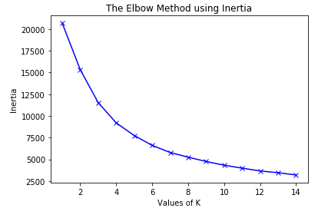
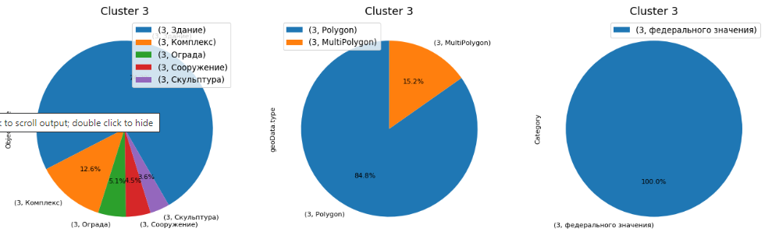
Segmentation of OKN and districts by the k-means method. CLUSTERING
An analysis of the segmentation of our objects is as follows:
0 Cluster - OKN only of regional importance, large objects: Large regionals
1 Cluster - the OKN category is not installed, the mix in all other parameters: Status-free
2 Cluster - only "point" windows of federal and regional significance. Burial only: Burial
3 Cluster - large OKNs of federal significance: Large federals

Slide 11
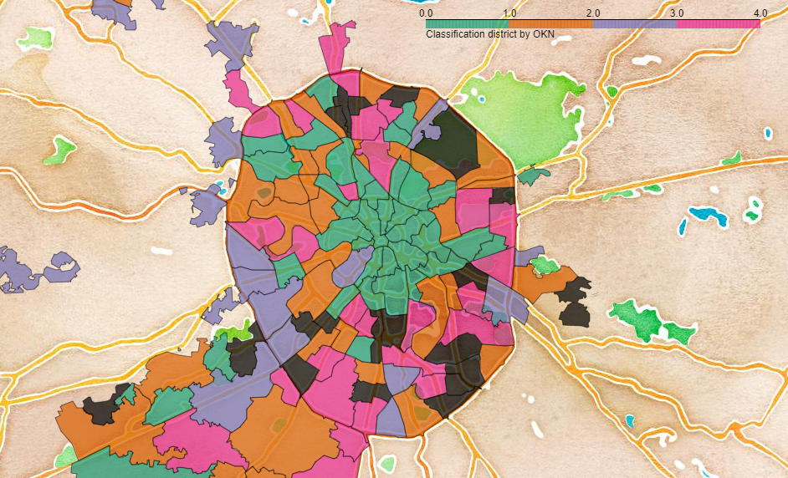
Choropleth of Moscow. Related districts of Moscow
From observations:
The center is kept together
Khamovniki feel uncomfortable in the galaxy of "elite" and rushes to the outlying areas ... interesting
New Moscow is not worse than the center, at least in terms of the OKN ratio

Slide 12
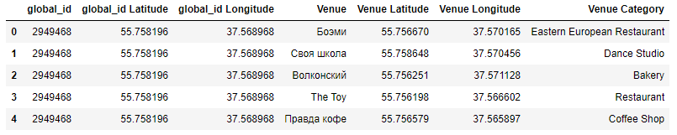
Add data with Foursquare
How the Foursquare data acquisition service works - we give them the coordinates of our OKNs, they return the POI category, its coordinates and name to us (in fact, there is a lot more data). The quantity depends on the presence of interesting places within walking distance. By the way, it’s possible that cultural monuments may fall into our search :)
And here is our fresh little dataset: almost 120 thousand lines and 421 one unique category of POI! Ufff, more than 50 million values) Of course, we saved it in advance and now use it for our purposes.

Slide 13
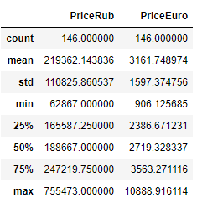
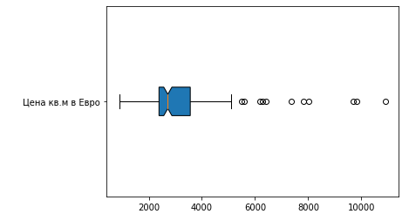
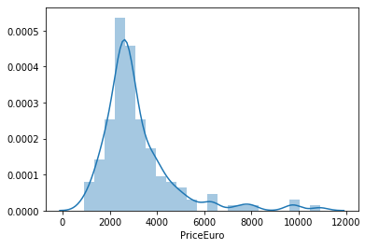
Housing price analytics in Moscow
The average price in Moscow is 3161 Euro per sq.m.
If the cost of housing is more than 5100 per 1 sq. M - the price is considered an “emission” ie goes beyond statistics and you should have an understanding of what you pay for

Slide 14
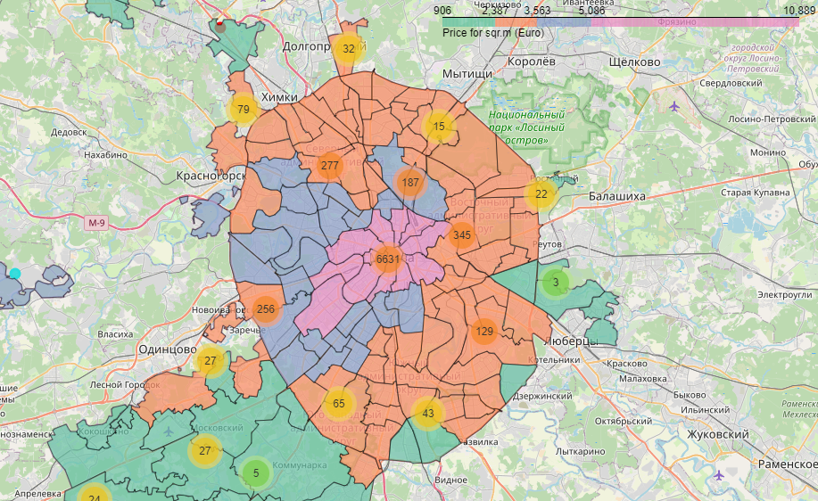
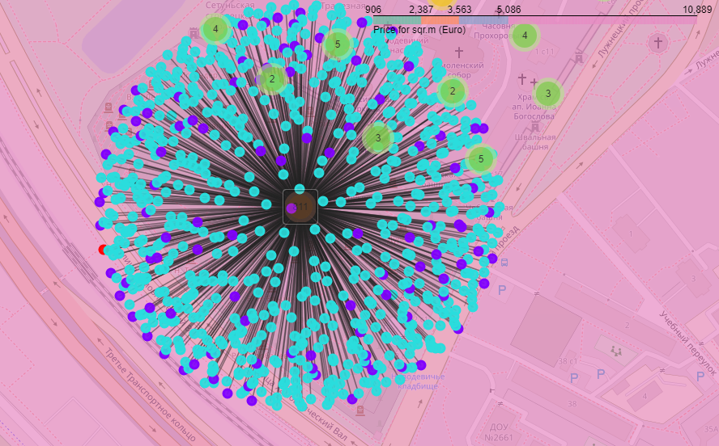
Choropleth of Moscow. Housing price analytics in Moscow
A small cartographic visualization on the cost of apartments in Moscow and cultural monuments located on its territory
Novodevichy Cemetery is a famous cemetery in Moscow.

Slide 15
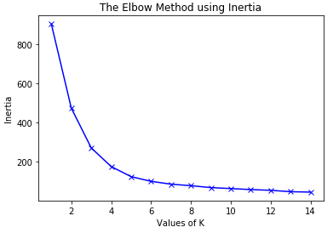
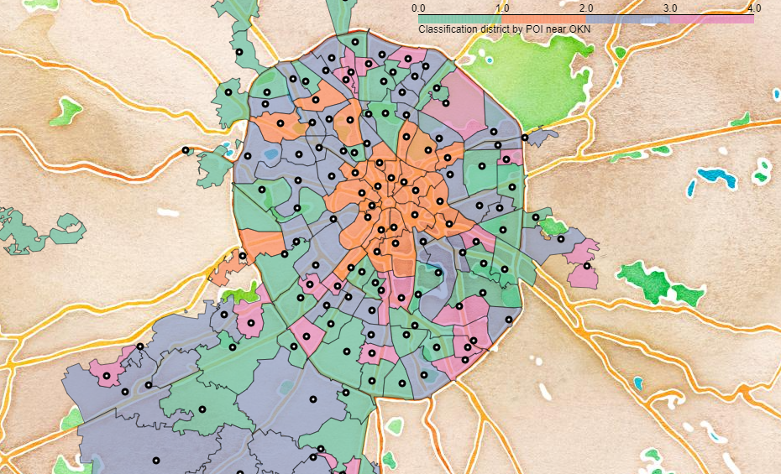
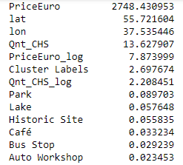
Choropleth of Moscow. Final
Ex. Cluster 0
The center was reunited in the first cluster (orange) - a high price tag for housing, a large number of OKN, a variety of infrastructure surrounding ancient monuments. The zero, green cluster is very similar to the second, purple, both in price and in the average number of OKNs in their territory. A characteristic difference of the zero cluster is a pronounced share in such POIs as a park, lake and historical sites, almost 20% of the infrastructure. The third cluster is the areas without OKN and related infrastructure.

